Slide 1
Database
Transaction Management
/Concurrency Control
Overview

Slide 2
Outline
Transaction
ACID Property
Schedule
Serial Schedule
Conflict Serializability
View Serializability
Strict Two-Phase Locking
A question

Slide 3
Transaction Concept
A transaction is a unit of program execution that accesses and possibly updates various data items.
A transaction must see a consistent database.
During transaction execution, the database may be inconsistent.
When the transaction is committed, the database must be consistent.

Slide 4
Transaction example
Transaction to transfer $50 from account A to account B:
1. read(A)
2. A := A – 50
3. write(A)
4. read(B)
5. B := B + 50
6. write(B)
Consistency requirement – the sum of A and B is unchanged by the execution of the transaction.
Atomicity requirement — if the transaction fails after step 3 and before step 6, the system should ensure that its updates are not reflected in the database, else an inconsistency will result.

Slide 5
Outline
Transaction
ACID Property
Schedule
Serial Schedule
Conflict Serializability
View Serializability
Strict Two-Phase Locking
A question

Slide 6
2. ACID Property
Atomicity
In a transaction, either all operations are carried out or none are.
Consistency
Regardless of other transactions, each transaction must preserve the consistency of the database
Isolation
User can understand a transaction without considering the effect of other transactions
Durability
The effect of transaction should persist forever whenever the transaction is completed/committed.

Slide 7
Outline
Transaction
ACID Property
Schedule
Serial Schedule
Conflict Serializability
View Serializability
Strict Two-Phase Locking
A question

Slide 8
3. Schedules
Schedule
A sequence of operations in a set of transactions {T₁, T₂, …, T_{n}}
E.g., a set of transactions is {T₁, T₂},

Slide 9
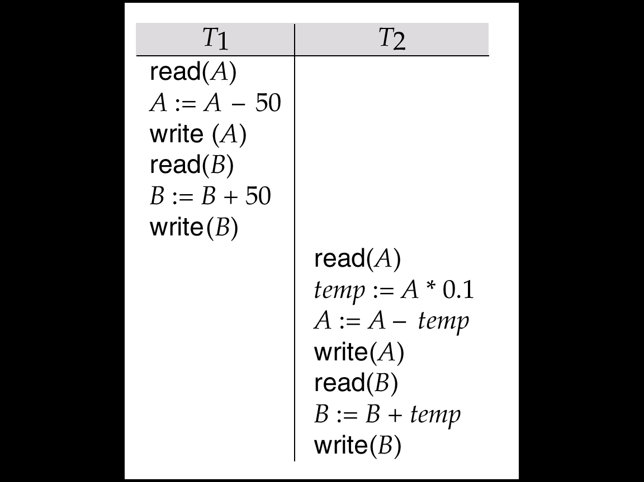
Example Schedule
Let T₁ transfer $50 from A to B, and T₂ transfer 10% of the balance from A to B. The following is a schedule, in which T₁ is followed by T₂.
Schedule 1

Slide 10
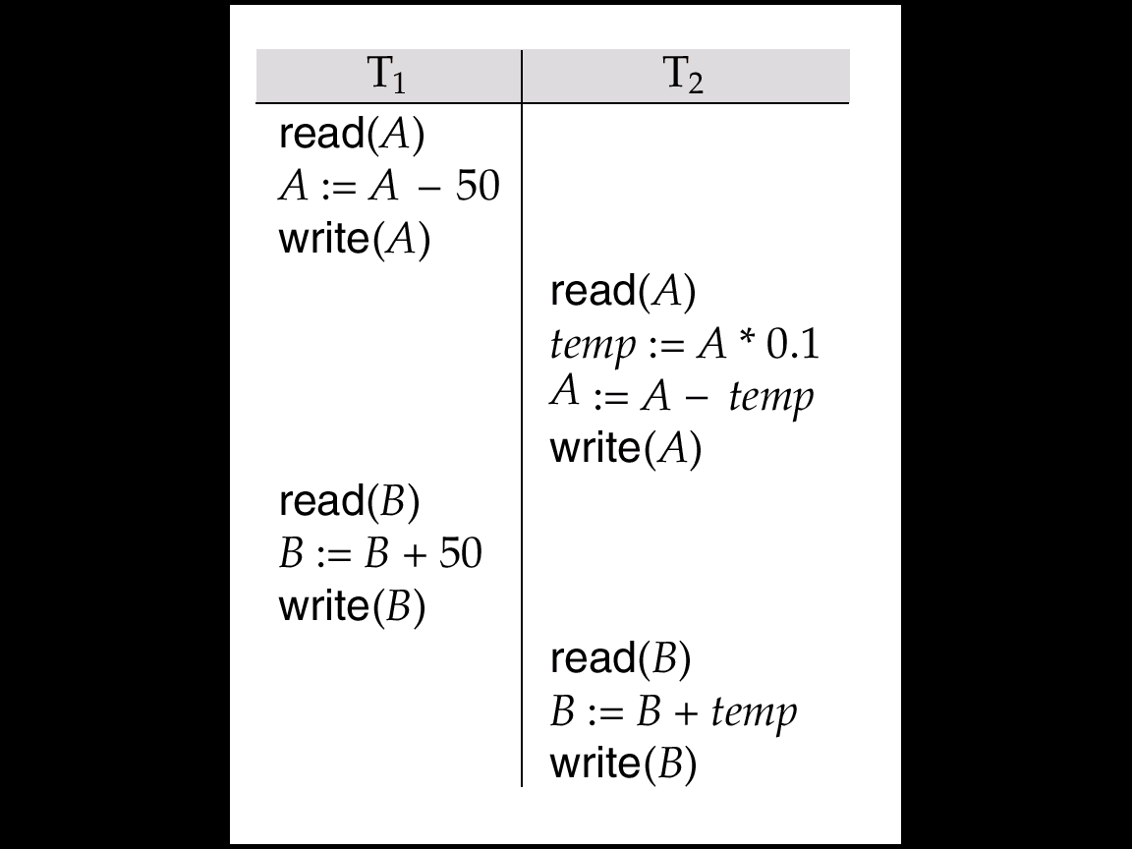
Example Schedule (Cont.)
Let T₁ and T₂ be the transactions defined previously. The following schedule 2 is equivalent to Schedule 1.
Schedule 2
In both Schedule 1 and 2, the sum A + B is preserved.

Slide 11
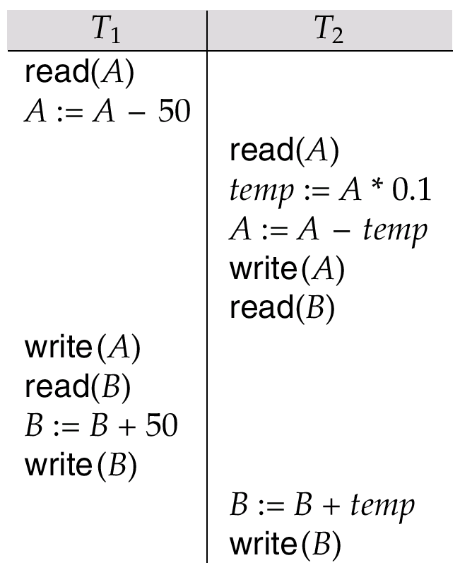
Example Schedules (Cont.)
The following concurrent schedule 3 does not preserve the value of the sum A + B.
schedule 3

Slide 12
Outline
Transaction
ACID Property
Schedule
Serial Schedule
Conflict Serializability
View Serializability
Strict Two-Phase Locking
A question

Slide 13
4. Serial Schedules
Serial schedule
A schedule which the operations belonging to one single transaction appear together
E.g. H₁ is a serial schedule (to T₁T₂) H₂ and H₃ are not serial schedule
Serializable schedules
equivalent to some serial schedule
E.g. H₁ and H₂ are serializable schedules (to T₁T₂)
H₃ is a serializable schedule (to T₂T₁).
T₁: | R(A), | W(A),
T₂: |  |  | R(B), | W(B)
H₁:
T₁: | R(A), |  | W(A),
T₂: |  | R(B), |  | W(B)
H₂:
T₁: |  | R(A), |  | W(A)
T₂: | R(B), |  | W(B),
H₃:

Slide 14
4. Serial Schedules
E.g. T₁ : R(A), W(A) T₂ : R(B), W(B)
Is schedule H₄ a serial schedule?
H₄:
T₁: |  |  | R(A), | W(A)
T₂: | R(B), | W(B),
Yes.
H₄: T₂ T₁

Slide 15
4. Serial Schedules
If T₃: Read(A), A=A+1, Write(A) T₄: Read(A), A=A+1, Write(A)
consider a serial schedule (T₃ T₄):
T₃ | T₄ | Value of A in DB
Read(A) |  | 5
A=A+1
Write(A)
 | Read(A)
 | A = A+1
 | Write(A)
5
6
5
6
6
6
6
7
6
7
7

Slide 16
4. Serial Schedules
If T₃: Read(A), A=A+1, Write(A) T₄: Read(A), A=A+1, Write(A)
consider a non-serial schedule:
T₃ | T₄ | Value of A in DB
Read(A) |  | 5
 | Read(A)
A=A+1
 | A = A+1
 | Write(A)
Write(A)
5
5
5
6
5
6
5
6
6
6
6

Slide 17
Outline
Transaction
ACID Property
Schedule
Serial Schedule
Conflict Serializability
View Serializability
Strict Two-Phase Locking
A question

Slide 18
5. Conflict Serializability
Two operations are conflict if
They are operations of different transactions on the same data object
At least one of them is a Write operation
E.g.
Two operations are non-conflict
E.g.
T_{i}: | W(X),
T_{j}: |  | R(X)
T_{i}: | R(X),
T_{j}: |  | W(X)
T_{i}: | W (X),
T_{j}: |  | W(X)
T_{i}: | R(X),
T_{j}: |  | R(X)
T_{i}: | W(X),
T_{j}: |  | R(Y)
T_{i}: | R(X),
T_{j}: |  | W(Y)
T_{i}: | W (X),
T_{j}: |  | W(Y)

Slide 19
5.1 Conflict Equivalent
Two schedules S₁ and S₂ are conflict equivalent if
S₁ and S₂ involve the same operations of the same transaction
Every pair of conflicting operations is ordered in the same way in S₁ and S₂

Slide 20
5.1 Conflict Equivalent
Two schedules involve the same operations of the same transaction
Every pair of conflicting operations is ordered in the same way in two schedules
E.g.1. Is H₈ and H₉ conflict equivalent?
T₁: | W (X), |  | R(Y),
T₂: |  | R(Y), |  | R(X)
H₈:
T₁: | W (X), | R(Y),
T₂: |  |  | R(Y), | R(X)
H₉:

Slide 21
5.1 Conflict Equivalent
Two schedules involve the same operations of the same transaction
Every pair of conflicting operations is ordered in the same way in two schedules
E.g.1. Is H₈ and H₉ conflict equivalent?
T₁: | W (X), |  | R(Y),
T₂: |  | R(Y), |  | R(X)
H₈:
Same Order?
X
Conflict Operations?
YES
T₁: | W (X), | R(Y),
T₂: |  |  | R(Y), | R(X)
H₉:
YES
T₁: | W (X), |  | R(Y),
T₂: |  | R(Y), |  | R(X)
H₈:
Y
Conflict Operations?
T₁: | W (X), | R(Y),
T₂: |  |  | R(Y), | R(X)
H₉:
NO
H₈ and H₉ are conflict equivalent

Slide 22
5.1 Conflict Equivalent
Two schedules involve the same operations of the same transaction
Every pair of conflicting operations is ordered in the same way in two schedules
E.g.2. Is H₈ and H₁₀ conflict equivalent?
T₁: | W (X), |  | R(Y),
T₂: |  | R(Y), |  | R(X)
H₈:
T₁: |  |  | W(X), | R(Y)
T₂: | R(Y), | R(X),
H₁₀:

Slide 23
5.1 Conflict Equivalent
Two schedules involve the same operations of the same transaction
Every pair of conflicting operations is ordered in the same way in two schedules
E.g.2. Is H₈ and H₁₀ conflict equivalent?
T₁: | W (X), |  | R(Y),
T₂: |  | R(Y), |  | R(X)
H₈:
X
T₁: |  |  | W(X), | R(Y)
T₂: | R(Y), | R(X),
H₁₀:
Conflict Operations?
YES
Same Order?
NO
H₈ and H₁₀ are NOT conflict equivalent

Slide 24
5.2 Conflict Serializability
S is conflict serializable if it is conflict equivalent to a serial schedule
E.g.
H₈ and H₉ are conflict equivalent
H₉ is a serial schedule
H₈ is conflict serializable
T₁: | W (X), |  | R(Y),
T₂: |  | R(Y), |  | R(X)
H₈:
T₁: | W (X), | R(Y),
T₂: |  |  | R(Y), | R(X)
H₉:

Slide 25
5.3 Precedence Graph
Test for conflict serializability
A directed graph G=(V,E), where
V includes all transactions involved in the schedule
E consists of all edges T_{i}→T_{j} for which one of three conditions holds:
T_{i} executes write(X) before T_{j} executes read(X)
T_{i} executes read(X) before T_{j} executes write(X)
T_{i} executes write(X) before T_{j} executes write(X)
Conflict Operations
T_{i}: | W(X),
T_{j}: |  | R(X)
T_{i}: | R(X),
T_{j}: |  | W(X)
T_{i}: | W (X),
T_{j}: |  | W(X)

Slide 26
5.3 Precedence Graph
The serialization order is obtained through topological sorting
A schedule S is conflict serializable iff G(S) is acyclic (i.e. no cycle)

Slide 27
5.3 Precedence Graph
E.g. Consider again the schedule H₈:
The Precedence graph is:
T₁: | W (X), |  | R(Y),
T₂: |  | R(Y), |  | R(X)
T₁
T₂
X
T₁: | W (X), |  | R(Y),
T₂: |  | R(Y), |  | R(X)
Conflict Operation
Y
T₁: | W (X), |  | R(Y),
T₂: |  | R(Y), |  | R(X)
No Conflict Operation
H₈ is conflict serializable and is conflict equivalent to T₁,T₂

Slide 28
5.3 Precedence Graph
E.g. Consider the schedule H₁₁:
The Precedence graph is:
T₁: | R(X), |  |  |  | R(Y)
T₂: |  | W(Y), |  | R(X),
T₃: |  |  | W(X),
T₁
T₂
T₃
T₁: | R(X), |  |  |  | R(Y)
T₂: |  | W(Y), |  | R(X),
T₃: |  |  | W(X),
X
Conflict Operation?
YES
T₁: | R(X), |  |  |  | R(Y)
T₂: |  | W(Y), |  | R(X),
T₃: |  |  | W(X),
Y
Conflict Operation?
YES
H₁₁ is NOT conflict serializable as the Precedence graph contains a cycle

Slide 29
Outline
Transaction
ACID Property
Schedule
Serial Schedule
Conflict Serializability
View Serializability
Strict Two-Phase Locking
A question

Slide 30
6. View Serializability
Two schedules S₁ and S₂, where the same set of transactions participates in both schedules. They are said to be view equivalent
If T_{i} reads the initial value of a data item in S₁, T_{i} also reads the initial value of the item in S₂.
If T_{i} reads an item produced by T_{j} in S₁, T_{i} also reads the item produced by T_{j} in S₂.
If T_{i} writes the final value of a data item in S₁, T_{i} also writes the final value of the item in S₂.

Slide 31
6.1 View Equivalent
S₁ and S₂ are view equivalent
1
S₁:
Initial Read
S₂:
Initial Read
X
Schedule
Schedule
T_{i}: R(X)
X
T_{i}: R(X)
2
S₁:
S₂:
Read
Read
T_{j}
T_{i}
T_{j}
T_{i}
T_{j}: W(X)
T_{i}: R(X)
T_{j}: W(X)
T_{i}: R(X)
Final Write
Final Write
3
S₁:
S₂:
Schedule
Schedule
T_{i}: W (X)
X
T_{i}: W (X)
X

Slide 32
6.2 View Serializability
S is view serializable if it is view equivalent to a serial schedule
Suppose S₁ is view equivalent to S₂.
S₂ is a serial schedule.
In other words, S₁ is view equivalent to a serial schedule S₁ is said to be view serializable.

Slide 33
6.2 View Serializability
E.g. Consider the schedule H₅:
Is it view serializable?
T₁: | R(X), |  |  |  | R(Y)
T₂: |  | R(Y), |  | R(X),
T₃: |  |  | W(X),
H₅:
Consider a serial schedule H₆ :T₁T₃T₂
T₁: | R(X), | R(Y),
T₂: |  |  |  | R(Y), | R(X)
T₃: |  |  | W(X),
H₆:

Slide 34
6.2 View Serializability
Read (Point 1 and Point 2)
E.g.
T₁: | R(X), |  |  |  | R(Y)
T₂: |  | R(Y), |  | R(X),
T₃: |  |  | W(X),
H₅:
X
T₁: | R(X), | R(Y),
T₂: |  |  |  | R(Y), | R(X)
T₃: |  |  | W(X),
H₆:
T₁: | R(X), |  |  |  | R(Y)
T₂: |  | R(Y), |  | R(X),
T₃: |  |  | W(X),
H₅:
Y
T₁: | R(X), | R(Y),
T₂: |  |  |  | R(Y), | R(X),
T₃: |  |  | W(X),
H₆:

Slide 35
6.2 View Serializability
Write (Point 3)
E.g.
T₁: | R(X), |  |  |  | R(Y)
T₂: |  | R(Y), |  | R(X),
T₃: |  |  | W(X),
H₅:
X
T₁: | R(X), | R(Y),
T₂: |  |  |  | R(Y), | R(X)
T₃: |  |  | W(X),
H₆:
T₁: | R(X), |  |  |  | R(Y)
T₂: |  | R(Y), |  | R(X),
T₃: |  |  | W(X),
H₅:
Y
T₁: | R(X), | R(Y),
T₂: |  |  |  | R(Y), | R(X)
T₃: |  |  | W(X),
H₆:

Slide 36
6.2 View Serializability
Answer
Yes, it is view serializable because it is view equivalent to
T₁T₃T₂ = R₁(X),R₁(Y),W₃(X),R₂(Y),R₂(X)

Slide 37
6.2 View Serializability
E.g.Consider the schedule H₇:
Is it view serializable?
T₁: | W (X), |  |  |  | R (Y)
T₂: |  | R(Y), | R (X), | W (Y),
H₇:
Read
T₁: | W (X), |  |  |  | R (Y)
T₂: |  | R(Y), | R (X), | W (Y),
T₂ reads from T₁
X
Y
T₁: | W (X), |  |  |  | R (Y)
T₂: |  | R(Y), | R (X), | W (Y),
T₁ reads from T₂
H₇ is NOT view serializable because T₂ reads from T₁ and T₁ reads from T₂

Slide 38
Outline
Transaction
ACID Property
Schedule
Serial Schedule
Conflict Serializability
View Serializability
Strict Two-Phase Locking
A question

Slide 39
Lock-Based Protocols
When several transactions execute concurrently, the isolation property may no longer be preserved.
Isolation: user can understand a transaction without considering the effect of other transactions
A lock is a mechanism to control concurrent access to a data item.
Lock requests are made to concurrency-control manager. Transaction can proceed only after request is granted.

Slide 40
Lock-Based Protocols
A lock is a mechanism to control concurrent access to a data item
Data items can be locked in two modes:
1. exclusive (X) mode. Data item can be both read as well as written. X-lock is requested using lock-X instruction.
2. shared (S) mode. Data item can only be read. S-lock is requested using lock-S instruction.

Slide 41
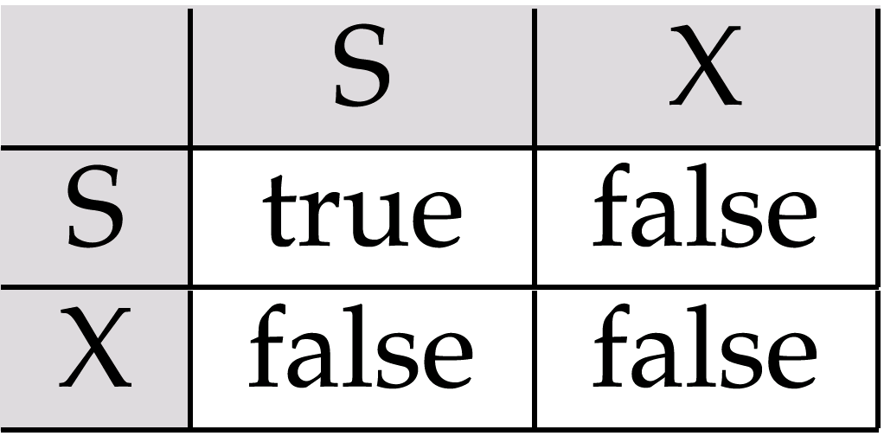
Lock-Based Protocols (Cont.)
Lock-compatibility matrix
Any number of transactions can hold shared locks on an item, but if any transaction holds an exclusive on the item, no other transaction may hold any lock on the item.
If a lock cannot be granted, the requesting transaction is made to wait till all incompatible locks held by other transactions have been released. The lock is then granted.

Slide 42
Lock-Based Protocols (Cont.)
Example of a transaction performing locking:
T₂: lock-S(A);
read (A);
unlock(A);
lock-S(B);
read (B);
unlock(B);
display(A+B)
A locking protocol is a set of rules followed by all transactions while requesting and releasing locks. Locking protocols restrict the set of possible schedules.

Slide 43
Strict Two-Phase Locking Protocol
Phase 1: Growing Phase
transaction may obtain locks
transaction may not release locks
Phase 2: Shrinking Phase
transaction may release locks
transaction may not obtain locks
The protocol assures serializability. It can be proved that the transactions can be serialized in the order of their lock points (i.e. the point where a transaction acquired its final lock).
Disadv: Deadlock may occur

Slide 44
7. Strict Two-Phase Locking Protocol
Two Kinds of Locks
Shared Lock - lock-S
Used when the transaction only read the data object
Allow read (for other transactions)
Not allow write (for other transactions)
Exclusive Lock - lock-X
Used when the transaction has a write operation on the data object
Not allow read (for other transactions)
Not allow write (for other transactions)
E.g.1. T₁: R(A), R(B), W(B)
Lock-S(A)
Lock-X(B)
unlock(A)
unlock(B)
T₁: R(A), R(B), W(B)
E.g.2. T2: R(B), R(A), W(A)
Lock-S(B)
T₂: R(B), R(A), W(A)
Lock-X(A)
unlock(A)
unlock(B)

Slide 45
7. Strict Two-Phase Locking Protocol
Lock-S(A)
Lock-X(B)
unlock(A)
unlock(B)
T₁: R(A), R(B), W(B)
Lock-S(B)
T₂: R(B), R(A), W(A)
Lock-X(A)
unlock(A)
unlock(B)
The Schedule should be:
Lock-S(A)
Lock-X(B)
T₁: R(A), R(B), W(B)
U(A)
U(B)
Lock-S(B)
Lock-X(A)
U(A)
U(B)
T₂: R(B), R(A), W(A)

Slide 46
7. Strict Two-Phase Locking Protocol
Lock-S(A)
Lock-X(B)
unlock(A)
unlock(B)
T₁: R(A), R(B), W(B)
Lock-S(B)
T₂: R(B), R(A), W(A)
Lock-X(A)
unlock(A)
unlock(B)
But, there may be a deadlock!
Lock-S(A)
Lock-X(B)
T₁: R(A), R(B), W(B)
U(A)
U(B)
Lock-S(B)
Lock-X(A)
U(A)
U(B)
T₂: R(B), R(A), W(A)
T₁ waits for the lock of B (i.e. T₁ waits for T₂ to release the lock of B)
T₂ waits for the lock of A (i.e. T₂ waits for T₁ to release the lock of A)

Slide 47
7. Strict Two-Phase Locking Protocol
View Serializable
Conflict Serializable
Strict Two Phase Locking
Serial

Slide 48
Outline
Transaction
ACID Property
Schedule
Serial Schedule
Conflict Serializability
View Serializability
Strict Two-Phase Locking
A question

Slide 49
8 Questions
Consider the following schedule:
(a) Draw the Precedence graph of the above schedule
T₁: |  | W(B)
T₂: | R(A) |  |  | R(B)
T₃: |  |  | W(A) |  | W(B)

Slide 50
8 Questions
T₁: |  | W(B)
T₂: | R(A) |  |  | R(B)
T₃: |  |  | W(A) |  | W(B)
(a) Draw the Precedence graph of the above schedule
Conflict Operation?
The Precedence graph is:
T₁: |  | W(B)
T₂: | R(A) |  |  | R(B)
T₃: |  |  | W(A) |  | W(B)
A
YES
T₁
T₂
Conflict Operation?
T₁: |  | W(B)
T₂: | R(A) |  |  | R(B)
T₃: |  |  | W(A) |  | W(B)
B
YES
T₃

Slide 51
8 Questions
T₁: |  | W(B)
T₂: | R(A) |  |  | R(B)
T₃: |  |  | W(A) |  | W(B)
(b) Is the schedule conflict serializable? Why? Please state the serialization order if it is conflict serializable.
The Precedence graph is:
Yes. This is because the Precedence graph does not contain any cycle.
T₁
T₂
T₂
T₁
T₃
T₃
The serialization order is T₁, T₂ and T₃.

Slide 52
8 Questions
(c) State the relation between the sets of conflict serializable schedules and view serializable schedules.
View Serializable
Conflict Serializable
The above set shows the relation between two sets of schedules.
If the schedule is conflict serializable, then it is also view serializable schedule.

Slide 53
8 Questions
(d) From the answer in parts (b) and (c), can you conclude whether the schedule is view serializable? If your answer is “Yes”, please state whether the schedule is view serializable.
From (b), we know that the schedule is conflict serializable.
From (c),
View Serializable
Conflict Serializable
YES. We can conclude that the schedule is view serializable

